Slide 1
CMSC 471
ML : Decision Trees
Slides courtesy: Tim Finin

Slide 2
Decision Trees (DTs)
A supervised learning method used for classification and regression
Given a set of training tuples, learn model to predict one value from the others
Learned value typically a class (e.g., goodRisk)
Resulting model is simple to understand, interpret, visualize, and apply

Slide 3
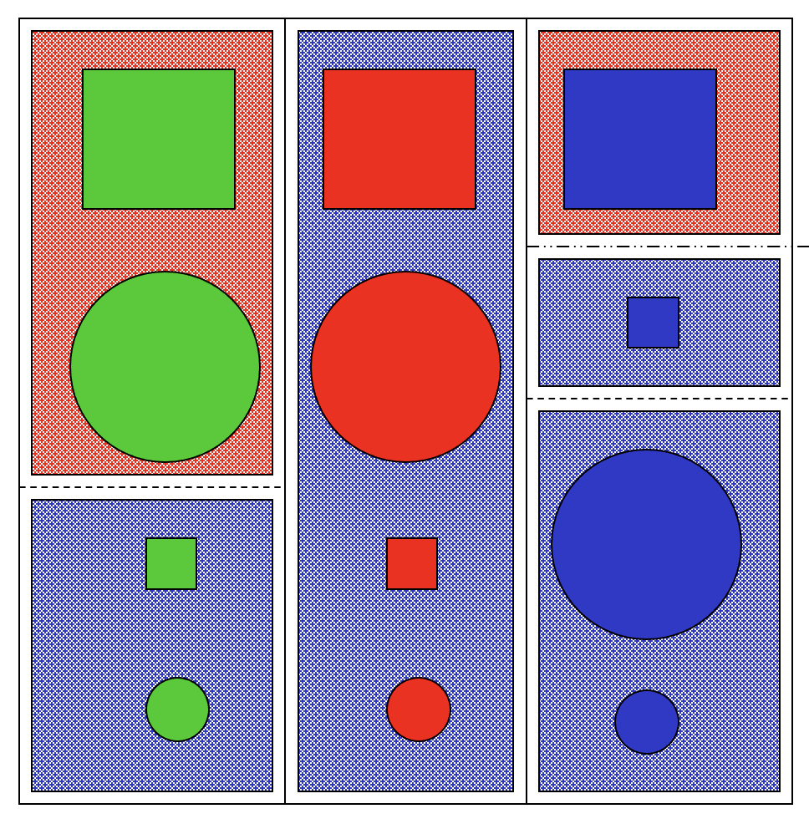
Learning a Concept
The red groups are negative examples, blue positive
Attributes
Size: large, small
Color: red, green, blue
Shape: square, circle
Task
Classify new object with a size, color & shape as positive or negative

Slide 4
Training data
Size | Color | Shape | class
Large | Green | Square | Negative
Large | Green | Circle | Negative
Small | Green | Square | Positive
Small | Green | Circle | positive
Large | Red | Square | Positive
Large | Red | Circle | Positive
Small | Red | Square | Positive
Small | Red | Circle | Positive
Large | Blue | Square | Negative
Small | Blue | Square | Positive
Large | Blue | Circle | Positive
Small | Blue | Circle | Positive

Slide 5
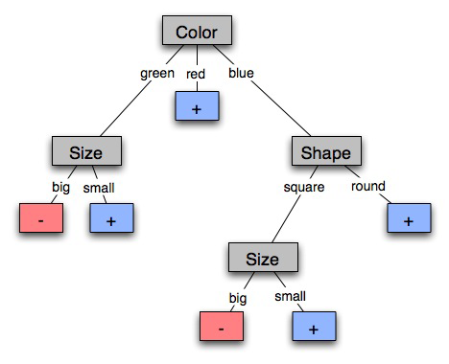
A decision tree-induced partition
The red groups are negative examples, blue positive
Negative things are big, green shapes and big, blue squares

Slide 6
Learning decision trees
Goal: Build decision tree to classify examples as positive or negative instances of concept using supervised learning from training data
A decision tree is a tree where
non-leaf nodes have an attribute (feature)
leaf nodes have a classification (+ or -)
each arc has a possible value of its attribute
Generalization: allow for >2 classes
e.g., classify stocks as {sell, hold, buy}
Color
green
red
blue
Size
+
Shape
big
small
square
round
-
+
Size
+
big
small
-
+

Slide 7
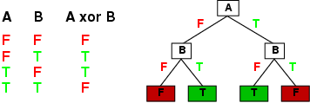
Expressiveness of Decision Trees
Can express any function of input attributes, e.g., for Boolean functions, truth table row → path to leaf:
There’s a consistent decision tree for any training set with one path to leaf for each example, but it probably won't generalize to new examples
Prefer more compact decision trees

Slide 8
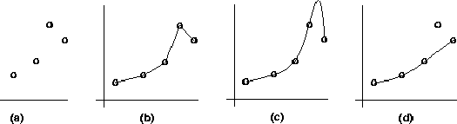
Inductive learning and bias
Suppose that we want to learn a function f(x) = y and we’re given sample (x,y) pairs, as in figure (a)
Can make several hypotheses about f, e.g.: (b), (c) & (d)
Preference reveals learning technique bias, e.g.:
prefer piece-wise functions (b)
prefer a smooth function (c)
prefer a simple function and treat outliers as noise (d)

Slide 9

Preference bias: Occam’s Razor
William of Ockham (1285-1347)
“non sunt multiplicanda entia praeter necessitatem”
entities are not to be multiplied beyond necessity
Simplest consistent explanation is the best
Smaller decision trees correctly classifying training examples preferred over larger ones
Finding the smallest decision tree is NP-hard, so we use algorithms that find reasonably small ones

Slide 10
R&N’s restaurant domain
Develop decision tree that customers make when deciding whether to wait for a table or leave
Two classes: wait, leave
Ten attributes: Alternative available? Bar in restaurant? Is it Friday? Are we hungry? How full is restaurant? How expensive? Is it raining? Do we have reservation? What type of restaurant is it? Estimated waiting time?
Set of 12 training examples
~7000 possible cases

Slide 11
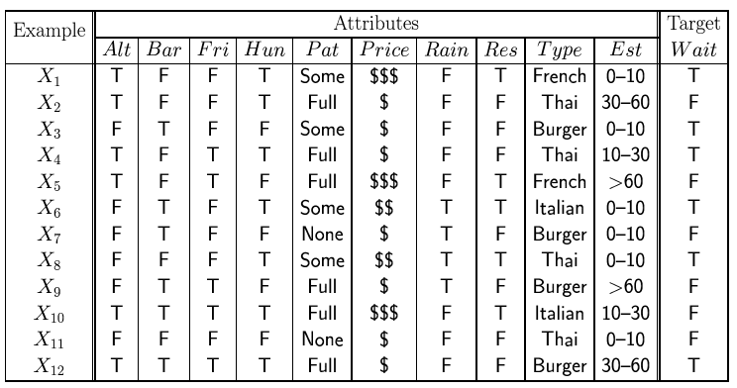
Attribute-based representations
Examples described by attribute values (Boolean, discrete, continuous), e.g., situations where will/won't wait for a table
Classification of examples is positive (T) or negative (F)
Serves as a training set

Slide 12
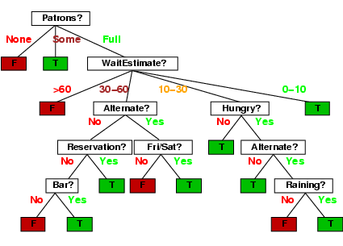
Decision tree from introspection

Slide 13

Issues
It’s like 20 questions
We can generate many decision trees depending on what attributes we ask about and in what order
How do we decide?
What makes one decision tree better than another: number of nodes? number of leaves? maximum depth?

Slide 14
ID3 / C4.5 / J48 Algorithm
Greedy algorithm for decision tree construction developed by Ross Quinlan circa 1987
Top-down construction of tree by recursively selecting best attribute to use at current node
Once attribute selected for current node, generate child nodes, one for each possible attribute value
Partition examples using values of attribute, & assign these subsets of examples to the child nodes
Repeat for each child node until examples associated with a node are all positive or negative

Slide 15
Choosing best attribute
Key problem: choose attribute to split given set of examples
Possibilities for choosing attribute:
Random: Select one at random
Least-values: one with smallest # of possible values
Most-values: one with largest # of possible values
Max-gain: one with largest expected information gain
Gini impurity: one with smallest gini impurity value
The last two measure the homogeneity of the target variable within the subsets
The ID3 algorithm uses max-gain

Slide 16
Restaurant: type vs patrons?
Random: Patrons or Wait-time; Least-values: Patrons; Most-values: Type; Max-gain: ???
French
Y
N
Y
N
Italian
Type variable
Thai
N
Y
N
Y
N
Y
N
Y
Burger
Empty
Some
Full
Patrons variable

Slide 17
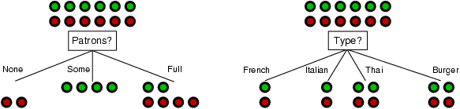
Choosing an attribute
stay
leave
Idea: good attribute splits examples into subsets that are (ideally) all positive or all negative
Which is better: Patrons? or Type?

Slide 18
Choosing an attribute
stay
leave
Idea: good attribute splits examples into subsets that are (ideally) all positive or all negative
Patrons: for six examples we know the answer and for six we can predict with prob. 0.67
Type: our prediction is no better than chance (0.50)

Slide 19
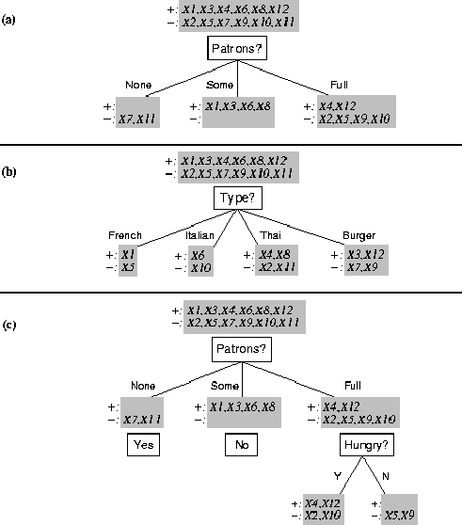
Splitting examples by testing attributes

Slide 20
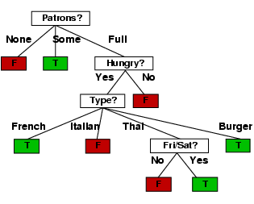
ID3-induced decision tree

Slide 21
Compare the two Decision Trees
Human-generated decision tree
ID3-generated decision tree

Slide 22
Information Entropy
Information entropy ... tells how much information there is in an event. More uncertain an event is, more information it contains
Receiving a message is an event
How much information is in these messages
The sun rose today!
It’s sunny today in Honolulu!
The coin toss is heads!
It’s sunny today in Seattle!
Life discovered on Mars!
None
A lot

Slide 23
Information theory 101
For n equally probable possible event or data values, each has probability 1/n
Information of a message is -log(p) = log(n)
e.g., with 16 messages, then log(16) = 4 and we need 4 bits to identify/send each message
For probability distribution P (p₁,p₂ … p_{n}) for n messages, its information (aka H or entropy) is:
I(P) = -(p₁*log(p₁) + p₂*log(p₂) + .. + p_{n}*log(p_{n}))

Slide 24
Entropy of a distribution
I(P) = -(p₁*log(p₁) + p₂*log(p₂) + .. + p_{n}*log(p_{n}))
Examples:
If P is (0.5, 0.5) then I(P) = 0.5*1 + 0.5*1 = 1
If P is (0.67, 0.33) then I(P) = -(2/3*log(2/3) + 1/3*log(1/3)) = 0.92
If P is (1, 0) then I(P) = 1*1 + 0*log(0) = 0
More uniform probability distribution, greater its information: more information is conveyed by a message telling you which event actually occurred
Entropy is the average number of bits/message needed to represent a stream of messages

Slide 25
Information for classification
To divide T records is into disjoint “answer” classes (C₁..C_{k}), the information needed to identify class of element of T is:
Info(T) = I(P)
where P is the probability distribution of partition (C₁,C₂,..,C_{k}):
Info(T) = I(|C₁|/|T|, |C₂|/|T|, ..., |C_{k}|/|T|)
C1
C2
C3
C1
C2
C3
C1
C2
C3
High information
Lower information
Still lower

Slide 26
Information for classification II
If we further divide T w.r.t. attribute X into sets {T₁,T₂, ..,T_{n}},
the information needed to identify class of an element of T is: the weighted average of information needed to identify class of an element of T_{i}, i.e., weighted average of Info(T_{i}):
Info(X,T) = Σ|T_{i}|/|T| * Info(T_{i})
C1
C2
C3
C1
C2
C3
High information
Low information

Slide 27
Information gain
Gain(X,T) = Info(T) - Info(X,T) is difference of
info needed to identify element of T and
info needed to identify element of T after value of attribute X known
This is gain in information due to attribute X
Used to rank attributes and build DT where each node uses attribute with greatest gain of those not yet considered in path from root
goal: create small DTs to minimize questions

Slide 28
Computing Information Gain
French
Y
N
Should we ask about restaurant type or how many patrons there are?
I(T) = ?
I (Pat, T) = ?
I (Type, T) = ?
Italian
Y
N
Thai
N
Y
N
Y
Burger
N
Y
N
Y
Empty
Some
Full
Gain (Patrons, T) = ?
Gain (Type, T) = ?
I(P) = -(p₁*log(p₁) + p₂*log(p₂) + .. + p_{n}*log(p_{n}))

Slide 29
Computing information gain
I(T) = - (.5 log .5 + .5 log .5) = .5 + .5 = 1
I (Pat, T) = 2/12 (0) + 4/12 (0) + 6/12 (- (4/6 log 4/6 + 2/6 log 2/6)) = 1/2 (2/3*.6 + 1/3*1.6) = .47
I (Type, T) = 2/12 (1) + 2/12 (1) + 4/12 (1) + 4/12 (1) = 1
French
Y
N
Italian
Y
N
Thai
N
Y
N
Y
Burger
N
Y
N
Y
Empty
Some
Full
Gain (Patrons, T) = 1 - .47 = .53
Gain (Type, T) = 1 – 1 = 0
I(P) = -(p₁*log(p₁) + p₂*log(p₂) + .. + p_{n}*log(p_{n}))

Slide 30
Computing information gain
I(T) = - (.5 log .5 + .5 log .5) = .5 + .5 = 1
I (Pat, T) = 2/12 (0) + 4/12 (0) + 6/12 (- (4/6 log 4/6 + 2/6 log 2/6)) = 1/2 (2/3*.6 + 1/3*1.6) = .47
I (Type, T) = 2/12 (1) + 2/12 (1) + 4/12 (1) + 4/12 (1) = 1
French
Y
N
Italian
Y
N
Thai
N
Y
N
Y
Burger
N
Y
N
Y
Empty
Some
Full
Gain (Patrons, T) = 1 - .47 = .53
Gain (Type, T) = 1 – 1 = 0
I(P) = -(p₁*log(p₁) + p₂*log(p₂) + .. + p_{n}*log(p_{n}))

Slide 31
How well does it work?
Case studies show that decision trees often at least as accurate as human experts
Study for diagnosing breast cancer had humans correctly classifying examples 65% of the time; DT classified 72% correct
British Petroleum designed DT for gas-oil separation for offshore oil platforms that replaced an earlier rule-based expert system
Cessna designed an airplane flight controller using 90,000 examples and 20 attributes per example

Slide 32
Extensions of ID3
Using alternate selection metric gain ratios, …
Real-valued data
Noisy data and overfitting
Generation of rules
Setting parameters
Cross-validation for experimental validation of performance
C4.5: extension of ID3 accounting for unavailable values, continuous attribute value ranges, pruning of decision trees, rule derivation, etc.

Slide 33
Real-valued data?
Many ML systems work only on nominal data
Select thresholds defining intervals so each becomes a discrete value of attribute
Use heuristics: e.g., always divide into quartiles
Use domain knowledge: e.g., divide age into infant (0-2), toddler (3-5), school-aged (5-8)
Or treat this as another learning problem
Try different ways to discretize continuous variable; see which yield better results w.r.t. some metric
E.g., try midpoint between every pair of values

Slide 34
Noisy data?
ML systems must deal with noise in training data
Two examples have same attribute/value pairs, but different classifications
Some attribute values wrong due to errors in the data acquisition or preprocessing phase
Classification is wrong (e.g., + instead of -) because of some error
Some attributes irrelevant to decision-making, e.g., color of a die is irrelevant to its outcome
Bias in the training data is a related problem

Slide 35
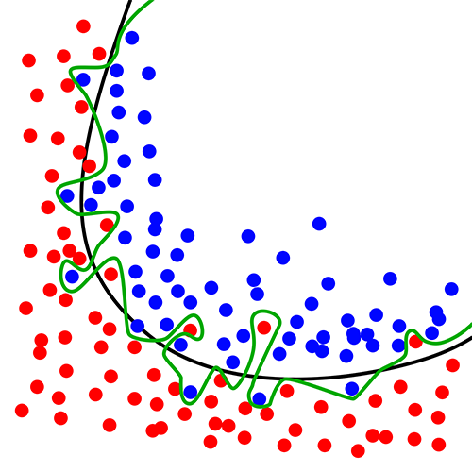
Overfitting ☹
Overfitting occurs when a statistical model describes random error or noise instead of underlying relationship
If hypothesis space has many dimensions (many attributes) we may find meaningless regularity in data irrelevant to true distinguishing features
Students with an m in first name, born in July, & whose SSN digits sum to a prime number get better grades in AI
If we have too little training data, even a reasonable hypothesis space can overfit

Slide 36
Avoiding Overfitting
Remove obviously irrelevant features
E.g., remove ‘year observed’, ‘month observed’, ‘day observed’, ‘observer name’ from feature vector
Getting more training data
Pruning lower nodes in a decision tree
E.g., if gain of best attribute at a node is below a threshold, stop and make this node a leaf rather than generating children nodes

Slide 37
Summary: decision tree learning
Widely used learning methods in practice for problems with relatively few features
Strengths
Fast and simple to implement
Can convert result to a set of easily interpretable rules
Empirically valid in many commercial products
Handles noisy data
Easy for people to understand
Weaknesses
Large decision trees may be hard to understand
Requires fixed-length feature vectors
Non-incremental (i.e., batch method)
Univariate splits/partitioning using only one attribute at a time so limits types of possible trees

